Slide 1
WELCOME
TO OUR
PROJECT

Slide 2
COMPARATIVE STUDY OVER SORTING ALGORITHMS
PREPARED BY
MD Rameez Raja (42)
Manish Kumar Gupta (26)
Arup Singha (31)
MD Imran Ansari (5)
Sujoya Das (17)
Swarna Basu (41)
Sarita Chaurasia (52)

Slide 3
CONTENT
* Introduction
* PLATFORM OF THE PROJECT
* Acknowledgement
* Why we choose this project
* Types of algorithm
* Why we need Asymptotic notation to measure complexity
* What we have done
* Conclusion

Slide 4
INTRODUCTION
In computer science, a sorting algorithm is an algorithm that puts elements of a list in a certain order. The most-used orders are numerical order and lexicographical order. Efficient sorting is important for optimizing the use of other algorithms (such as search and merge algorithms) that require sorted lists to work correctly; it is also often useful for canonicalizing data and for producing human-readable output. More formally, the output must satisfy two conditions:
1. The output is in nondecreasing order (each element is no smaller than the previous element according to the desired total order);
2. The output is a permutation (reordering) of the input.
Since the dawn of computing, the sorting problem has attracted a great deal of research, perhaps due to the complexity of solving it efficiently despite its simple, familiar statement. For example, bubble sort was analyzed as early as 1956.[1] Although many consider it a solved problem, useful new sorting algorithms are still being invented (for example, library sort was first published in 2006). Sorting algorithms are prevalent in introductory computer science classes, where the abundance of algorithms for the problem provides a gentle introduction to a variety of core algorithm concepts, such as big O notation, divide and conquer algorithms, data structures, randomized algorithms, best, worst and average case analysis, time-space tradeoffs, and lower bounds.

Slide 5
PLATFORM OF THE PROJECT
* Front End :- C Language.
* Back End :- No such data base ; Random input from the users.
* Project type :- Analytical Project.
* Project Goal :- Try to possible ; proposed an algorithm which is best sorting algorithm according to complexity
WHAT IS OBJECTIVE OF SORTING?
* The objective is to take an unordered set of comparable data items and arrange them in order.
* We will usually sort the data into ascending order sorting into descending order is very similar.
* Data can be sorted in various ADTs, such as arrays and TREES.
Copyright ©: University of Illinois CS 241 Staff

Slide 6
Application of sorting
* For searching on unsorted data by comparing keys, optimal solutions require θ(n) comparisons.
* For searching on sorted data by comparing keys, optimal solutions require θ(log n) comparisons.
* Sorting data for users
BEST CASE : Best case time complexity of an algorithm is a measure of an minimum time that the algorithm is required for an input size N.
Copyright ©: University of Illinois CS 241 Staff

Slide 7
WORST CASE : Worst case time complexity of an algorithm is a measure of an maximum time that the algorithm is required for an input size N.
AVERAGE CASE : Average case the time complexity of an algorithm will required to execute a typical input data of size N is known as average case time complexity.

Slide 8
ACKNOWLEDGEMENT
The analysis of the project work wishes to express my gratitude to Mr. Tofique Ahmad Gazi for allowing the degree attitude and providing effective guidance in development of this project work. His conscription of the topic and all the helpful hints, he provided, contributed greatly to successful development of this work, without being pedagogic and overbearing influence.
I also express my sincere gratitude to Mr. Tofique Ahmad Gazi .
Finally, I take this opportunity to thank to Dr. Arun Kumar Dey Principal of Elite Polytechnic Institude for giving us the scope of carrying out the project work.

Slide 9
WHY WE CHOOSE THIS PROJECT ?
* An internal sort requires that the collection of data fit entirely in the computer’s main memory.
* Sorting is a process that organizes a collection of data into either ascending or descending order.
* We can use an external sort when the collection of data cannot fit in the computer’s main memory all at once but must reside in secondary storage such as on a disk.
* We will analyze only internal sorting algorithms.
* Sorting also has indirect uses. An initial sort of the data can significantly enhance the performance of an algorithm.

Slide 10
* Majority of programming projects use a sort somewhere, and in many cases, the sorting cost determines the running time.
* A comparison-based sorting algorithm makes ordering decisions only on the basis of comparisons.
Among different types of sorting algorithm each has its advantages and disadvantages and to determine which algorithm is better and faster for sorting a set of data we have done a comparative study of different types of sorting algorithms.

Slide 11
TYPES OF ALGORITHMS
1.American flag sort
2.Bead sort
3.Bogo sort
4.Bubble sort
5.Bucket sort
6.Cartesian sort
7.Cocktail sort
8.Comb sort
9.Counting sort
10.Cycle sort
11. Flash sort
12.Heap sort
13.Insertion sort
14.Intro sort
15.Merge sort
16.Odd even sort
17.Quick sort
18.Radix sort
19.Selection sort
20.Shell sort

Slide 12
* BUCKET SORT :
Like counting sort, bucket sort is fast because it assumes something about the input. Whereas counting sort assumes that the input consists of integers in a small range, bucket sort assumes that the input is generated by a random process that distributes elements uniformly.
* HEAP SORT :
It is a well-known, traditional sorting algorithm you will be expected to know
Heapsort is always O(n log n)
  Quicksort is usually O(n log n) but in the worst case slows to O(n²)
  Quicksort is generally faster, but Heapsort is better in time-critical applications.
Heapsort is a really cool algorithm!

Slide 13
MERGE SORT :
merge sort O(n log n) comparison based sorting algorithm. Most implementations produce a stable sort, which means that the implementation preserves the input order of equal elements in the sorted output. Merge sort is a divide and conquer algorithm that was invented by John von Neumann in 1945.
RADIX SORT :
In computer science, radix sort is a non comparative integer sorting algorithm that sorts data with integer keys by grouping keys by the individual digits which share the same significant position and value. A positional notation is required, but because integers can represent strings of characters and specially formatted floating point numbers, radix sort is not limited to integers.

Slide 14
WHY WE NEED ASYMPTOTIC NOTATION TO MEASURE COMPLEXITY
* For given function g(n),we denote by o(g(n)) the set of functions that are different than g(n) by a constant Asymptotic upper bound.
* Here, we assume that we should compare the algorithm in an independent machine, i.e; if there is different types of processor, then their system may vary the execution time depending on the instruction format for execution each and every operations. If we consider two different machine for any algorithm to measure the complexity then we should prefer ASSYMTOTIC NOTATION.

Slide 15
SNAP SHORT

Slide 16
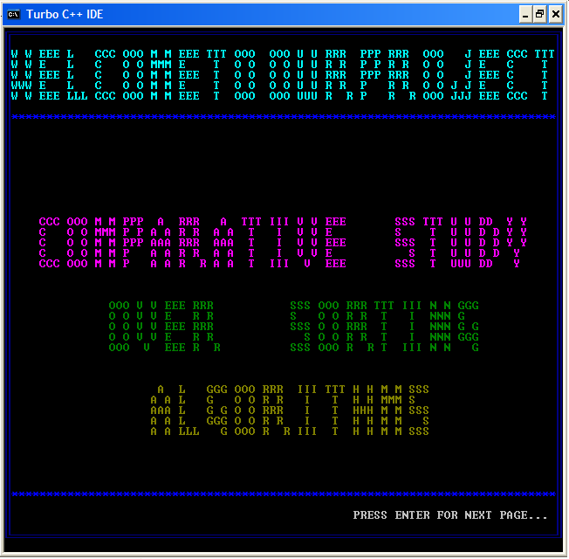
WHAT WE HAVE DONE ?

Slide 17
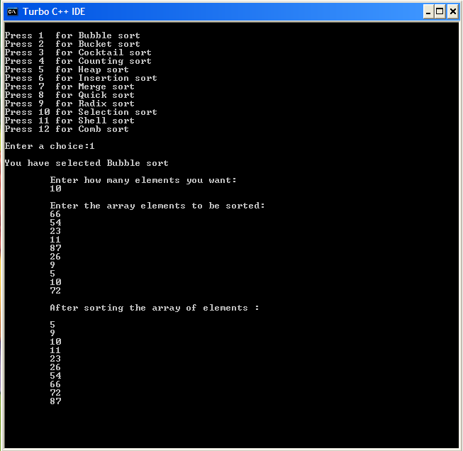
BUBBLE SORT PROGRAM OUTPUT (SCREEN SHOT)

Slide 18
PROGRAM OF BUBBLE SORT
for(int I =N; I >0; I -- )
{
for(int j =1; j < I; j ++)
{
if (arr [j -1] >arr [j])
{
temp = arr [j-1];
arr [j-1]=arr [j];
arr [j] = temp ;
}
}
}
EXAMPLE :
5 | 3 | 2 | 4
3 | 5 | 2 | 4
3 | 2 | 5 | 4
3 | 2 | 4 | 5
2 | 3 | 4 | 5
Copyright ©: University of Illinois CS 241 Staff

Slide 19
CONCLUSION
By analyzing an algorithm, we mean to study the performance of an algorithm including the assertion of its correctness and a determination of the cost of its execution. Although a given algorithm is often analyzed in a particular way that is most suitable for such an algorithm, we are more interested in general procedures and techniques that can be used to study the performance of classes of algorithms. To be able to talk about general analysis techniques will not only add to our understanding of the behavior of a class of algorithms but will also, in many cases, lead to useful synthesis procedures. A good example illustrating these points is the various techniques that can be used to analyze a class of sorting algorithms which can be modelled as networks made up of comparator modules. In this paper, we discuss several approaches to such an analysis problem. Moreover, synthesis procedures suggested by these analysis techniques will also be presented.

Slide 20
THE END

Slide 21
THANK YOU

